Slide 1


All-Optical Logic Gates using Semiconductor Optical Amplifiers(SOA)
Review-I
AY 2025-26
Capstone Project – Introduction (PROJ2999)
GITAM (Deemed-to-be) University
Department of Electrical Electronics and Communication Engineering
Project Team:
Dayanand Bisanal (BU22EECE0100435)
Tejas D (BU22EECE0100426)
Chetan Kumar Swadi (BU22EECE0100436)
Project Mentor:
Dr. Subhashish Tiwari
Project In-charge:
Dr. Jaya Prakash Sahoo
www.gitam.edu

Slide 2
Objective and Goals
Objective
To design and simulate a suite of all-optical logic gates using the non-linear properties of Semiconductor Optical Amplifiers (SOAs) in the OptiSystem software. This project aims to demonstrate the feasibility of all-optical digital circuits for high-speed communication systems.
Goals
Main Goals
Phase 1 (Completed): Design and simulate an all-optical XOR gate at a specified data rate using the SOA-MZI architecture and Cross-Phase Modulation (XPM).
Phase 2 (In Progress): Design and simulate the remaining fundamental logic gates (AND, OR, NOT) using SOAs and other components like MZI and delay interferometers.
Phase 3 (Future): Implement more complex circuits, such as a full adder and full subtractor, by combining the basic logic gates designed in the previous phases.
Additional Goals
Analyze the performance of the designed gates using metrics such as Quality Factor (QF), Extinction Ratio (ER), and Bit Error Rate (BER).
Investigate the effects of various parameters like injection current, data rate, and Amplified Spontaneous Emission (ASE) on the performance of the logic gates.

Slide 3
Project Plan (Clearly mention milestone for objectives under each reviews)
Phase #3
Review #1
Review #2
Nov 10
Kick Off
Sept 26
Phase #2
--
Aug 20
Oct 24
Phase #1
Sept 22
Aug
Sept
Oct
Nov
Preparatory Phase
100%
Aug 8 – Nov 10
Phase 1 Work Effort
100%
Aug 20 - Sep 22
Phase 2 Work Effort
80%
Sept 27 – Oct 24
Phase 3 Work Effort
60%
Oct 24 - Nov 15
Delivery Phase
Nov 21

Slide 4
Literature Survey
Key Publications
"All optical logic gate using SOA" (2004, Journal of the Korean Physical Society)
Key Takeaways: This paper demonstrates how both Cross-Gain Modulation (XGM) and Cross-Phase Modulation (XPM) can be used to implement all fundamental logic gates (AND, OR, XOR, NOT, NOR, XNOR) at speeds up to 20 Gbps. It highlights the compact size, stability, and integration capability of SOA-based devices, which are crucial for complex systems like full adders.
2. "Design and Simulation of SOA based Optical NAND gate for photonics FPGA" (2021, 2nd International Conference for Emerging Technology)
Key Takeaways: This work focuses on the universal NAND gate and utilizes the Four-Wave Mixing (FWM) non-linear property of SOAs. It emphasizes that universal gates are key building blocks for more complex circuits like photonic FPGAs.
3. "Design of Full Adder and Subtractor Based on MZI - SOA" (2015, SPACES-2015)
Key Takeaways: This paper proposes a systematic model for an all-optical full adder and full subtractor based on the MZI-SOA configuration. It successfully validates the designs using OptiSystem, confirming that complex arithmetic circuits can be effectively realized by properly combining the output terminals of MZI-SOA components.
4. "All optical Full-Adder and Full-Subtractor using Semiconductor Optical Amplifiers and All-Optical Logic Gates" (2020, 7th International Conference on Signal Processing and Integrated Networks)
Key Takeaways: This paper presents a schematic design for a full adder and full subtractor using fundamental logic gates (AND, OR, XOR, NOT) that are themselves based on SOA principles. It uses XPM and simulates the design in OptiSystem, validating the outputs for specific input sequences.

Slide 5
Literature Survey
Key Publications
5. "Design of all-optical D flipflop using SOA-MZI Architecture" (2021, International Conference on Artificial Intelligence and Smart Systems)
Key Takeaways: This research demonstrates that beyond combinational circuits, all-optical sequential circuits like a D flip-flop can also be built using SOA-MZI architecture. It shows how cascading fundamental gates (NAND and NOT) can create memory elements, which are vital for optical computing.
6. Design and analysis of SOA-MZI based optical digital circuits for high speed optical networks" (2023, e-Prime - Advances in Electrical Engineering)
Key Takeaways: This paper provides a comprehensive analysis of various all-optical digital circuits, including converters, using the SOA-MZI configuration. It specifically details a 10 Gbps operation and evaluates performance with metrics like Q-factor and BER, establishing a benchmark for signal quality.
7. "Design and analysis of carrier reservoir SOA based 2x1 MUX with enable input..." (2024, Optical and Quantum Electronics)
Key Takeaways: This is an advanced study that uses Carrier Reservoir SOAs (CR-SOAs) to achieve an ultra-high data rate of 120 Gbps. It highlights how multiplexers can be used as universal building blocks for basic logic gates, demonstrating a highly flexible and versatile approach to all-optical circuit design.
Key Resources – Whitepaper| Application Notes | Datasheet| Others
OptiSystem Software: A powerful and widely-used software for designing, simulating, and analyzing optical components and systems, as demonstrated in multiple research papers we've reviewed.

Slide 6
Literature Survey
Existing Implementations – Products| Opensource| GitHub etc
Optical Logic Gates & Circuits: Research has focused on implementing individual gates like XOR, NAND, and NOR, as well as more complex circuits like full adders, full subtractors, and flip-flops using various technologies, with a strong focus on SOA-MZI configurations.
Hybrid Systems: Companies like Intel, IBM, and Cisco are pioneering silicon photonics, which integrates optical components like waveguides and modulators onto electronic chips. These hybrid systems are already used in data centers for high-speed, low-latency interconnects.
Photonic Integrated Circuits (PICs): These are chips that integrate multiple optical components, such as lasers, modulators, and waveguides, into a compact platform. PICs are essential for making scalable and practical optical processors.
Specialized Applications: All-optical signal processing is being explored for specific applications such as all-optical switches, data encoding, packet switching, signal regeneration, and header recognition in telecommunication systems.
Optical Neural Networks (ONNs): Startups are developing optical processors tailored for artificial intelligence and machine learning, leveraging the high bandwidth and parallel processing capabilities of light.

Slide 7
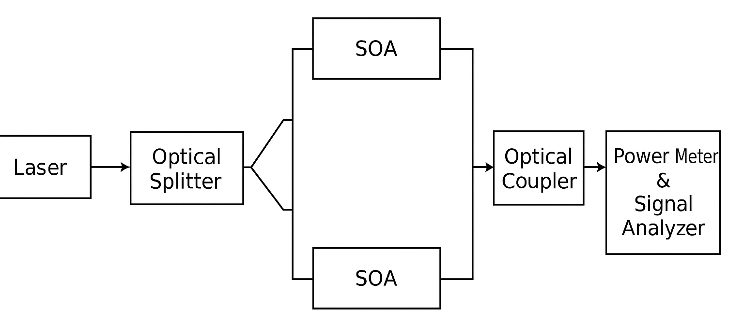
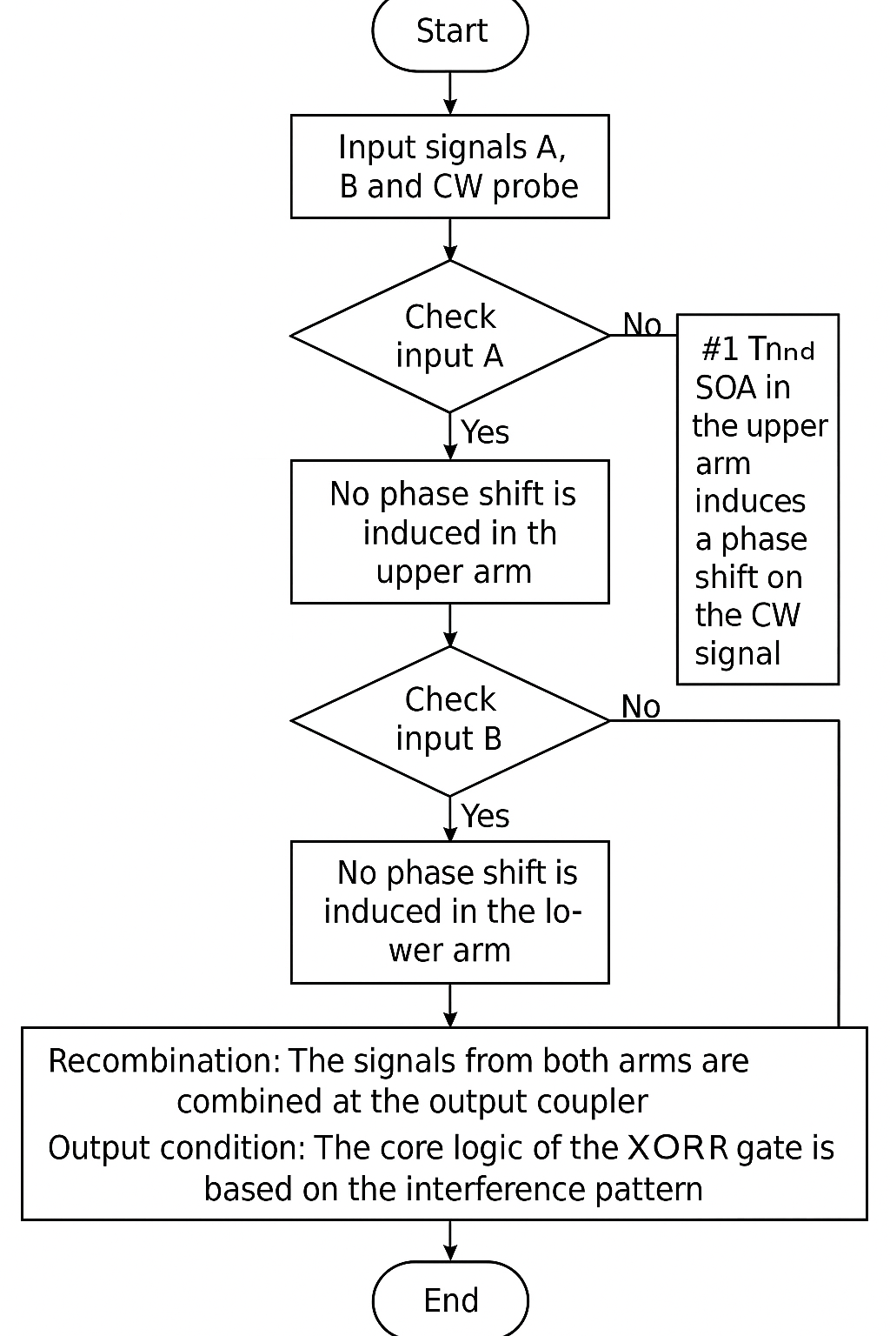
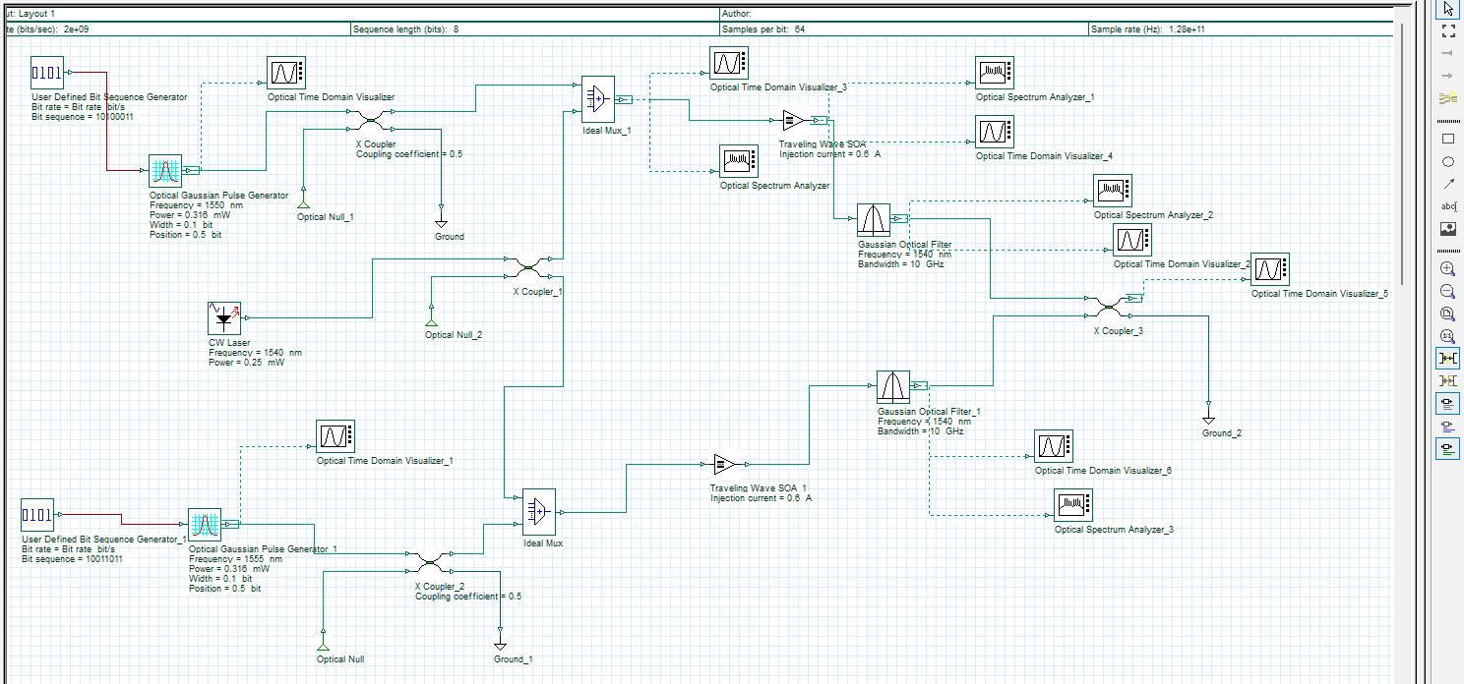
Architecture (XOR Gate)
Structural Diagram
Block Diagram/Pin Diagram
Behaviour Diagram
Flow chart/ State machine

Slide 8
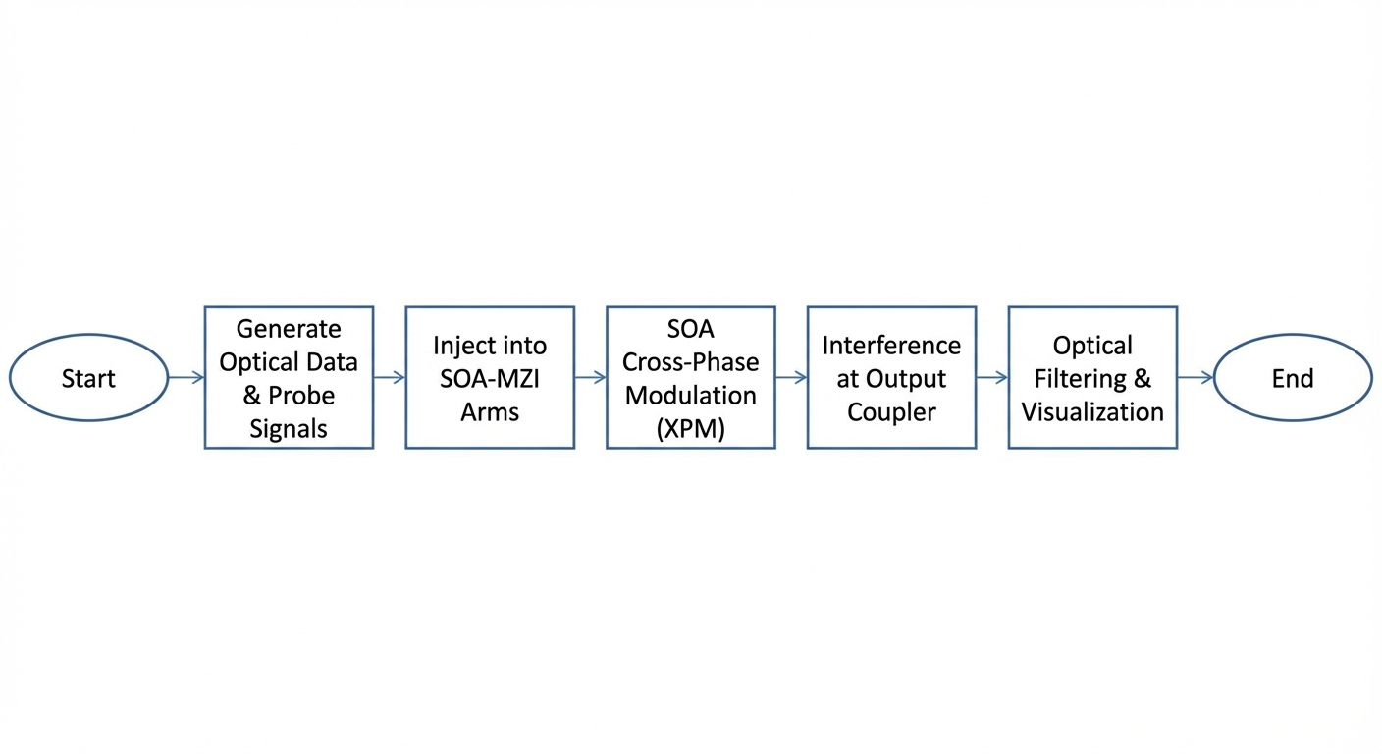
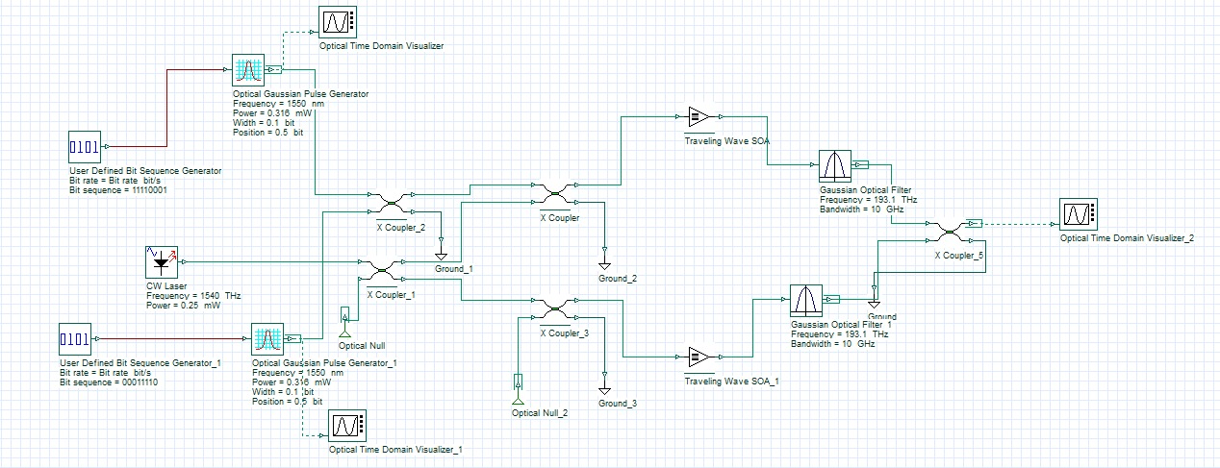
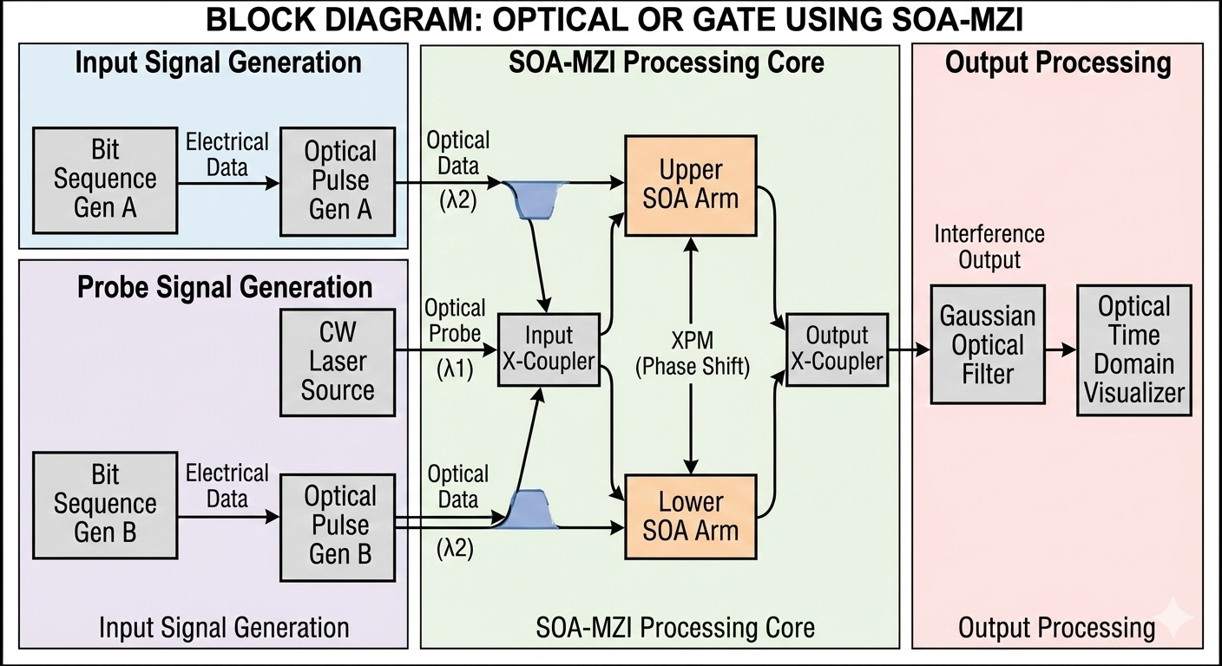
Architecture (OR Gate)
Behaviour Diagram
Flow chart/ State machine
Structural Diagram
Block Diagram/Pin Diagram

Slide 9
Use Cases & Testing
Use Cases
High-Speed All-Optical Switching: The designed logic gates can act as fundamental components in high-speed optical switches, which are essential for directing data traffic in future communication networks.
Optical Signal Processing: The logic gates can be used for tasks like data encoding, signal regeneration (3R regeneration), and packet recognition, which enhance the overall efficiency and security of optical communication systems.
All-Optical Computing: By combining these logic gates, we can build more complex digital circuits like half adders, full adders, and half subtractors, which are the building blocks of all-optical arithmetic logic units (ALUs).
Future Networks: The project serves as a foundational step toward realizing fully all-optical networks and integrated photonic circuits, which promise higher data rates and lower power consumption by eliminating the need for optical-to-electrical conversions.
Memory Elements: Our work on gates like NAND can be extended to create memory elements such as flip-flops and latches, as mentioned in existing research, which are critical for optical storage and data latching devices.
Test Cases
Truth Table Verification: We will verify the functionality of each designed logic gate (XOR, AND, OR, NOT) by applying all possible input combinations (e.g., 00, 01, 10, 11 for a two-input gate) and confirming that the output matches the expected Boolean logic.
Signal Integrity Analysis: Using the BER Analyzer and Optical Time Domain Visualizer in OptiSystem, we will evaluate the output signal quality. We will check the Eye Diagram to analyze key metrics like Q-factor, Extinction Ratio (ER), and Eye Height.
Data Rate Performance: We will test our designs at a specific data rate (e.g., 2 Gbps for the XOR gate and potentially higher for other gates) to analyze performance degradation, which is a common challenge due to SOA carrier recovery time.
Parameter Optimization: We will analyze the impact of various parameters such as input power, SOA injection current, and filter bandwidth on the performance of our circuits, as explored in the literature.

Slide 10
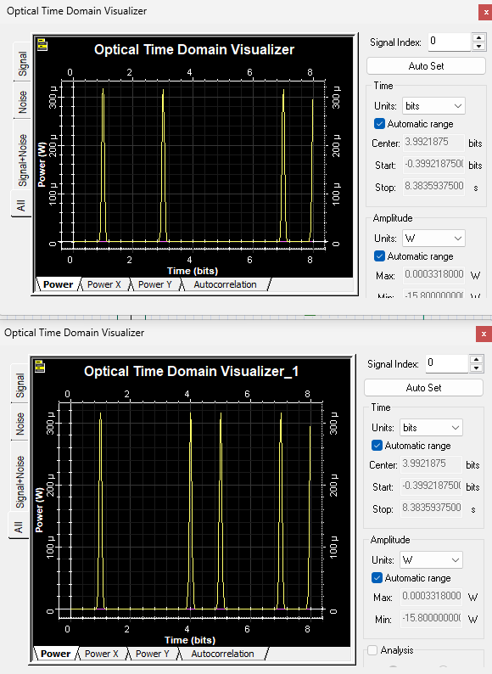
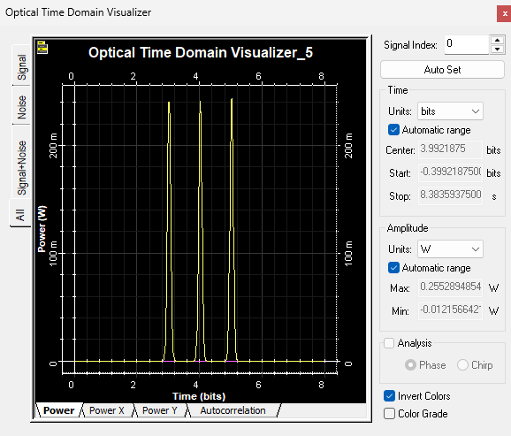
Implementation and Results – Iteration 1
Iteration 1 : Results
Sample input
10100011
Design Description:
"We designed a 2 Gbps all-optical XOR gate in OptiSystem using a Mach-Zehnder Interferometer (MZI) with SOAs in each arm."
"The gate's operation relies on the Cross-Phase Modulation (XPM) non-linear effect, which induces a phase shift on the probe signal depending on the presence of the data signals.“
"The interference of the signals at the output coupler results in the XOR logic: high output when the inputs are different and low when they are the same."
00111000
Sample output:
10011011

Slide 11
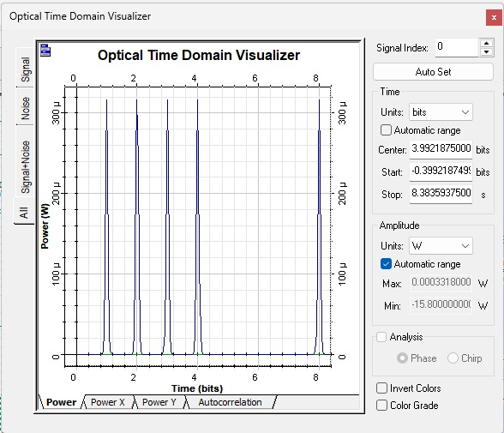
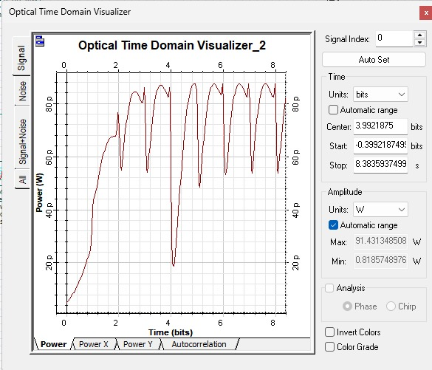
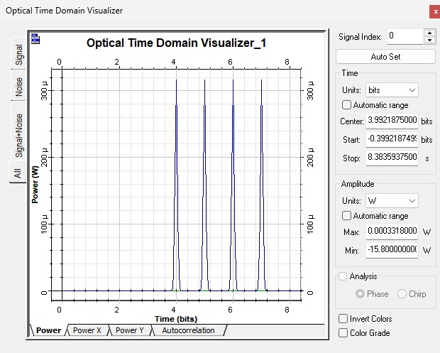
Implementation and Results – Iteration 2
Iteration : Results + Validation against the use cases and test cases
Sample input
11110001
Sample output:
00111000
Design Description:
"we designed an OR gate that operates entirely with light. We used a Mach-Zehnder Interferometer configuration with SOAs in the arms. The key principle here is Cross-Phase Modulation. Essentially, when our data signal hits the SOA, it changes the refractive index, which shifts the phase of our probe light. If either input A or input B is present, this phase shift allows the light to pass through to the output, successfully creating the OR logic”
00011110

Slide 12
Conclusion & Future Work
Summary and Conclusion
The initial design and simulation of an all-optical XOR gate using SOA-MZI architecture has been successfully completed in OptiSystem.
This confirms the potential of using SOA's non-linear properties to perform fundamental logic operations in the optical domain.
Future Work
Our next steps will be to complete the design and simulation of the remaining basic logic gates (AND, OR, NOT) using similar principles.
Ultimately, we plan to combine these gates to build and simulate more complex digital circuits like a full adder and full subtractor, showcasing the building-block nature of this approach.
We will also perform a detailed performance analysis of these circuits, evaluating key parameters like Q-factor and Extinction Ratio.

Slide 13
THANK YOU
Have a Great Day !

